Slide 1

MY SQL DB

Slide 2
SESSION OVERVIEW:
DATA BASE CONNECTION
TABLE CREATION
CURD OPERATION
COMMIT & ROLLBACK

Slide 3
Python MySQL
Python can be used in database applications.
One of the most popular databases is MySQL
Python needs a MySQL driver to access the MySQL database.
we will use the driver "MySQL Connector".
We recommend that you use PIP to install "MySQL Connector".
PIP is most likely already installed in your Python environment.
Now in the Command Prompt execute the Following Command
pip install mysql-connector-python

Slide 4
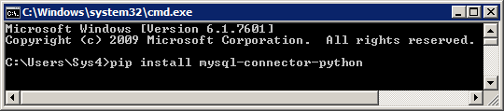
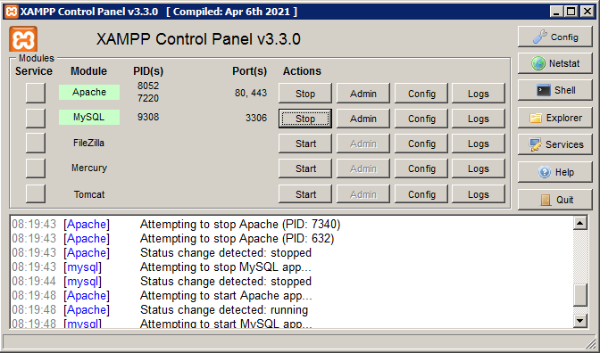
Test MySQL Connector
To test if the installation was successful, or if you already have "MySQL Connector" installed,
If the above code was executed with no errors, "MySQL Connector" is installed and ready to be used.
We will be Using XAMPP to know the Immediate Results

Slide 5
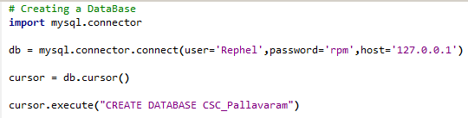
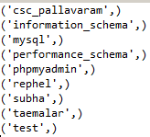
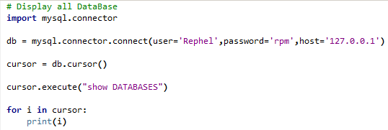
DATA BASE CONNECTION
To create a database in MySQL, use the "CREATE DATABASE" statement:

Slide 6
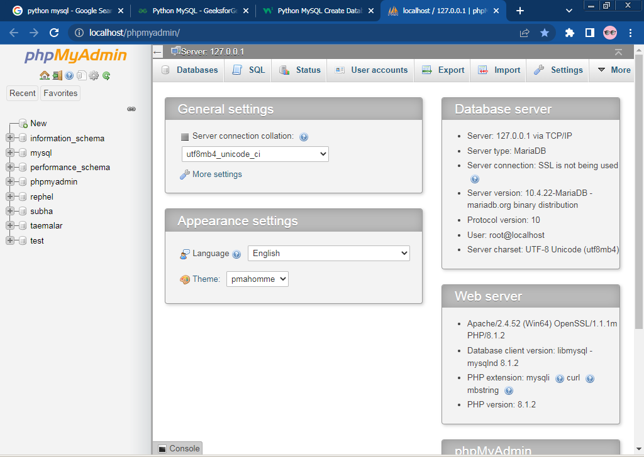
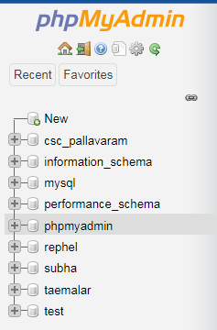

Slide 7
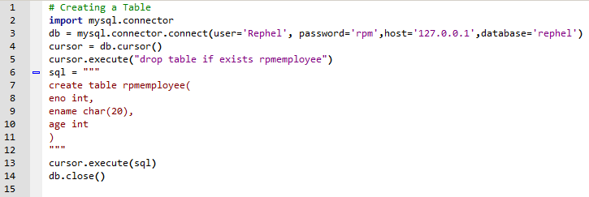
TABLE CREATION

Slide 8
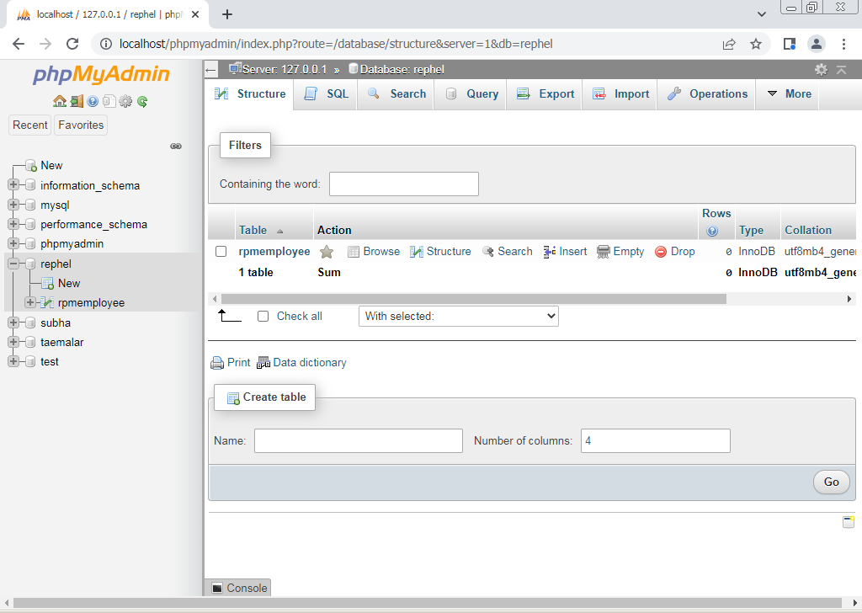

Slide 9
OTHER OPERATIONS
To commit the current transaction and make its changes permanent, you use the COMMIT statement.
To roll back the current transaction and cancel its changes, you use the ROLLBACK statement.
To close the connection in mysql database we use the function CLOSE() which disconnect from database.

Slide 10
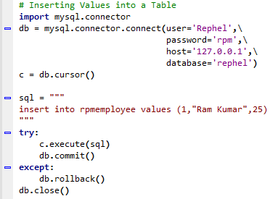
INSERT

Slide 11
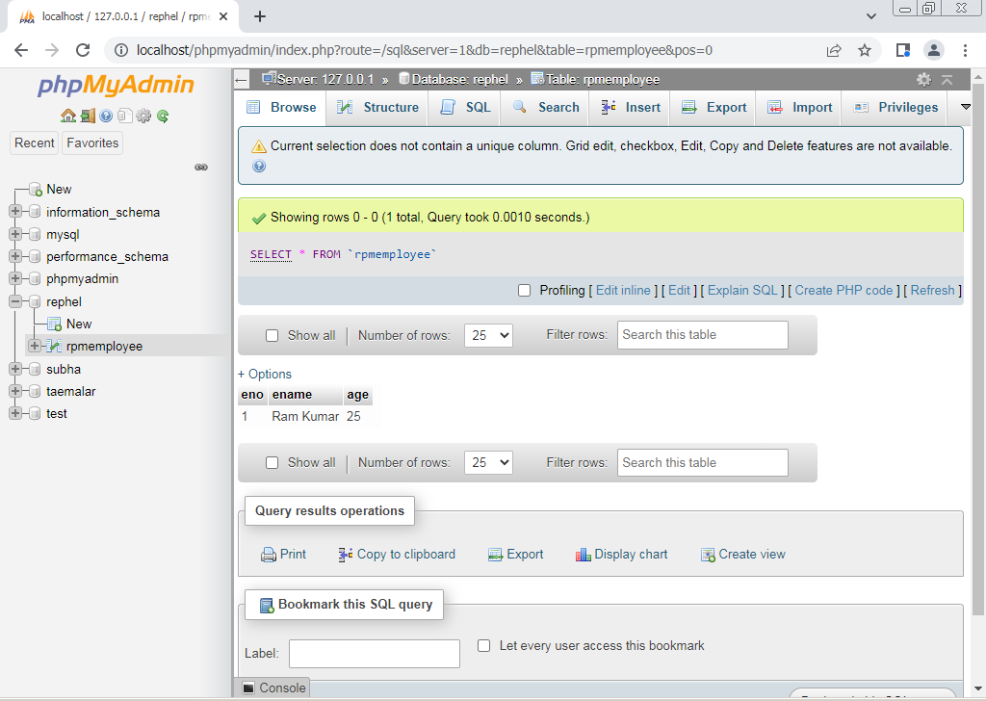

Slide 12
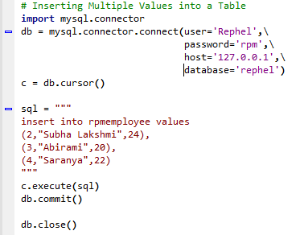
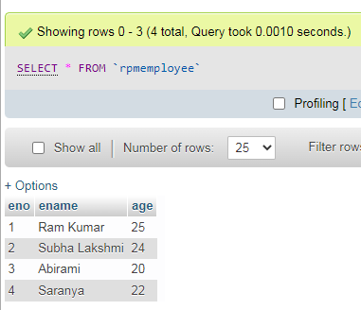

Slide 13
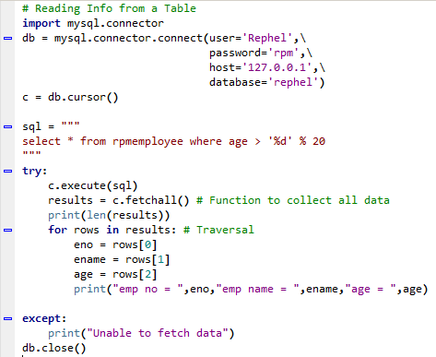

READ

Slide 14
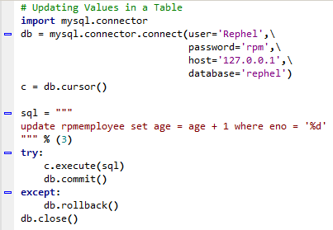
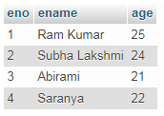
UPDATE

Slide 15
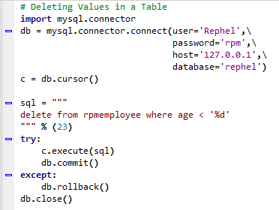
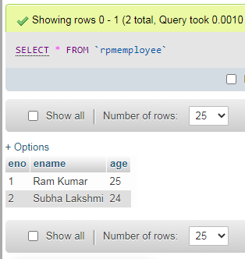
DELETE

Slide 16

CODING IS FUN ! THANK YOU !!

